Slide 1


Slide 2

INTRODUCTION - Engage
S2
What is Safety
What does it mean to be safe?

Slide 3
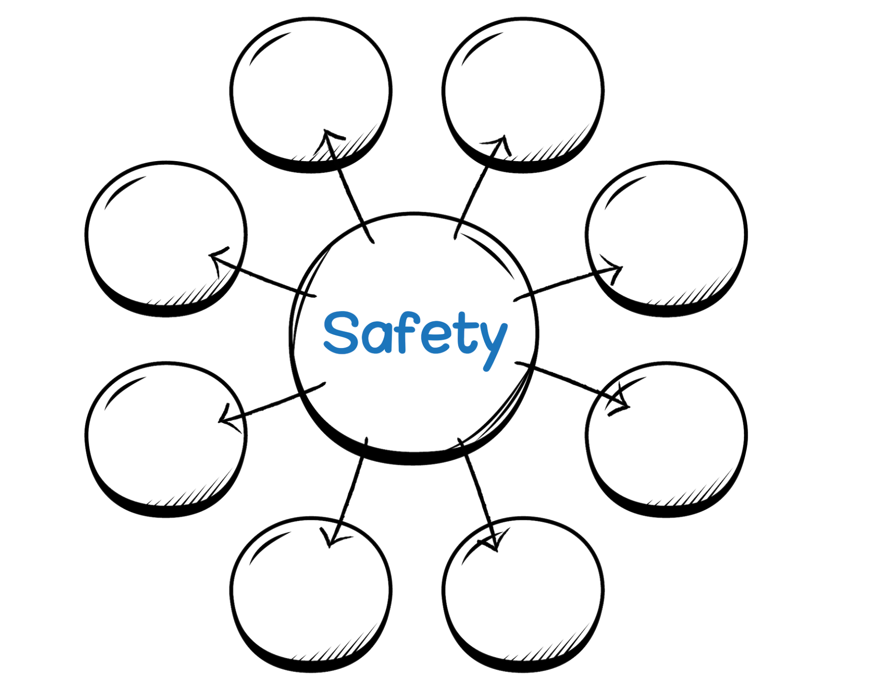
S3

Slide 4

INTRODUCTION - Engage
S4
How do you stay safe at home?
What are some things you do to stay safe at home?

Slide 5
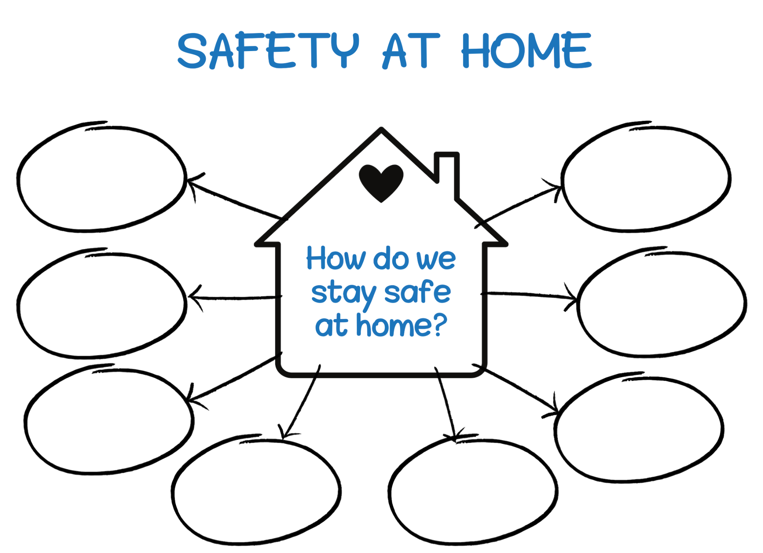
S5

Slide 6


Safe and Unsafe or Hazardous
S6

Slide 7

INTRODUCTION- Explore
S7
What is this item?
Where would we find it in our home?
ORGANIZING HOME ITEMS - Activity

Slide 8
S8
Where would we find it
in our home?
What is this item?
Living Room
Bedroom
Kitchen
Dining Room
Bathroom
Garage
Laundry Room
Notes:
On Slideshow View, click on the appropriate room button, to take you to that slide.

Slide 9

INTRODUCTION- Explore
S9
ORGANIZING HOME ITEMS - Activity
What is this item?
Where would we find it in our home?

Slide 10
S10
Where would we find it in our home?
What is this item?
Living Room
Bedroom
Kitchen
Dining Room
Bathroom
Garage
Laundry Room
Notes:
On Slideshow View, click on the appropriate room button, to take you to that slide.

Slide 11
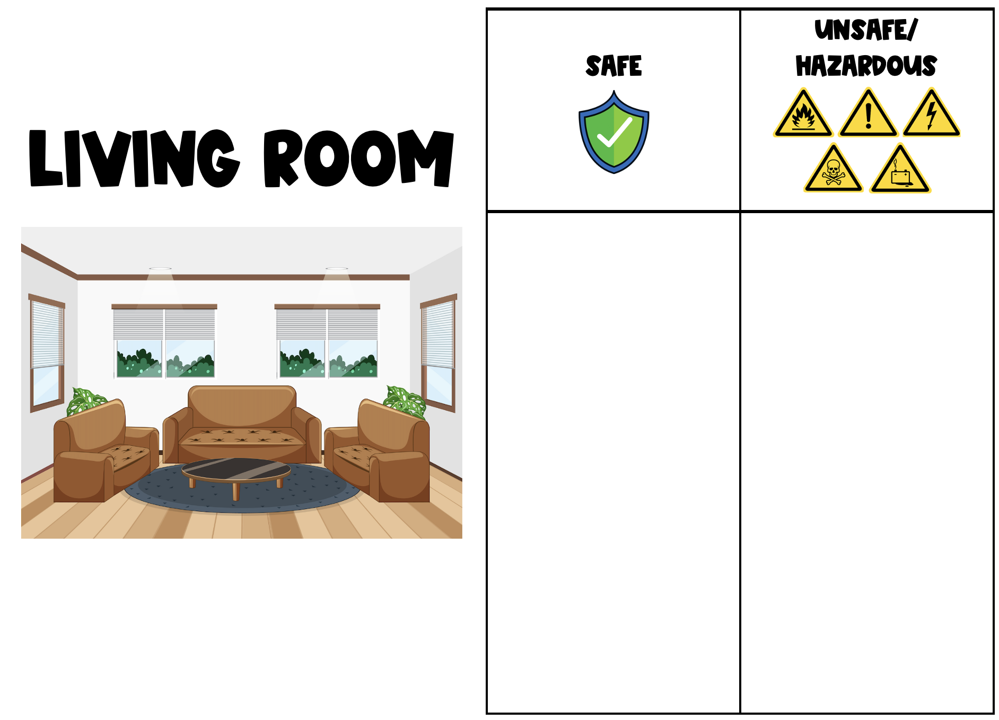
S11a

Slide 12
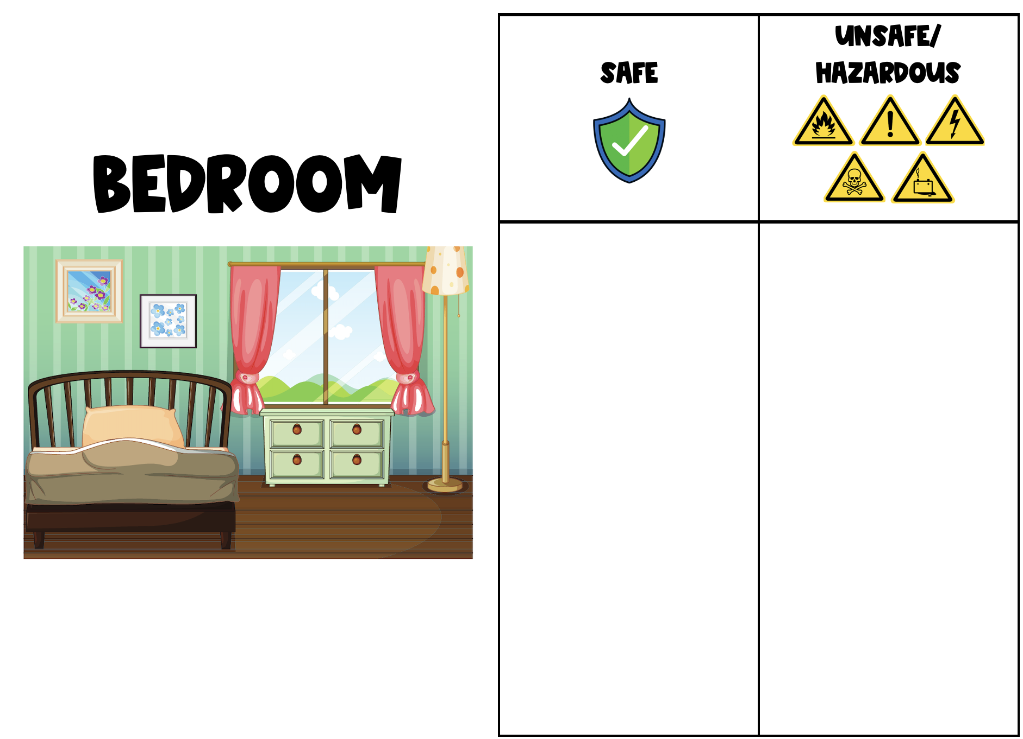
S11b

Slide 13
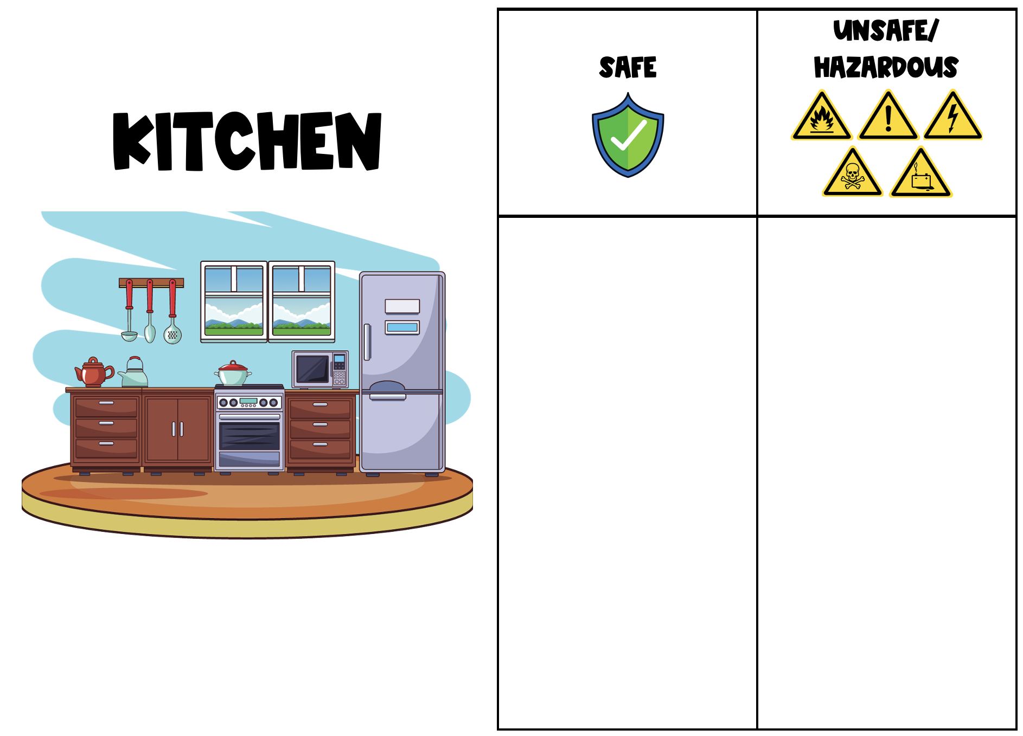
S11c

Slide 14
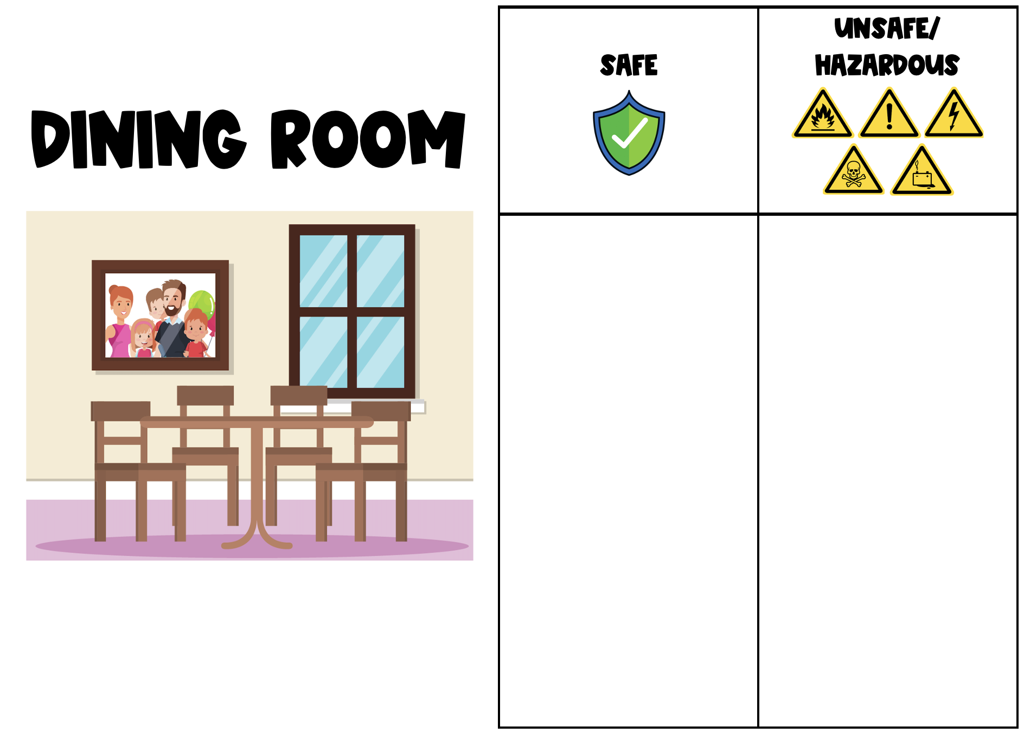
S11d

Slide 15
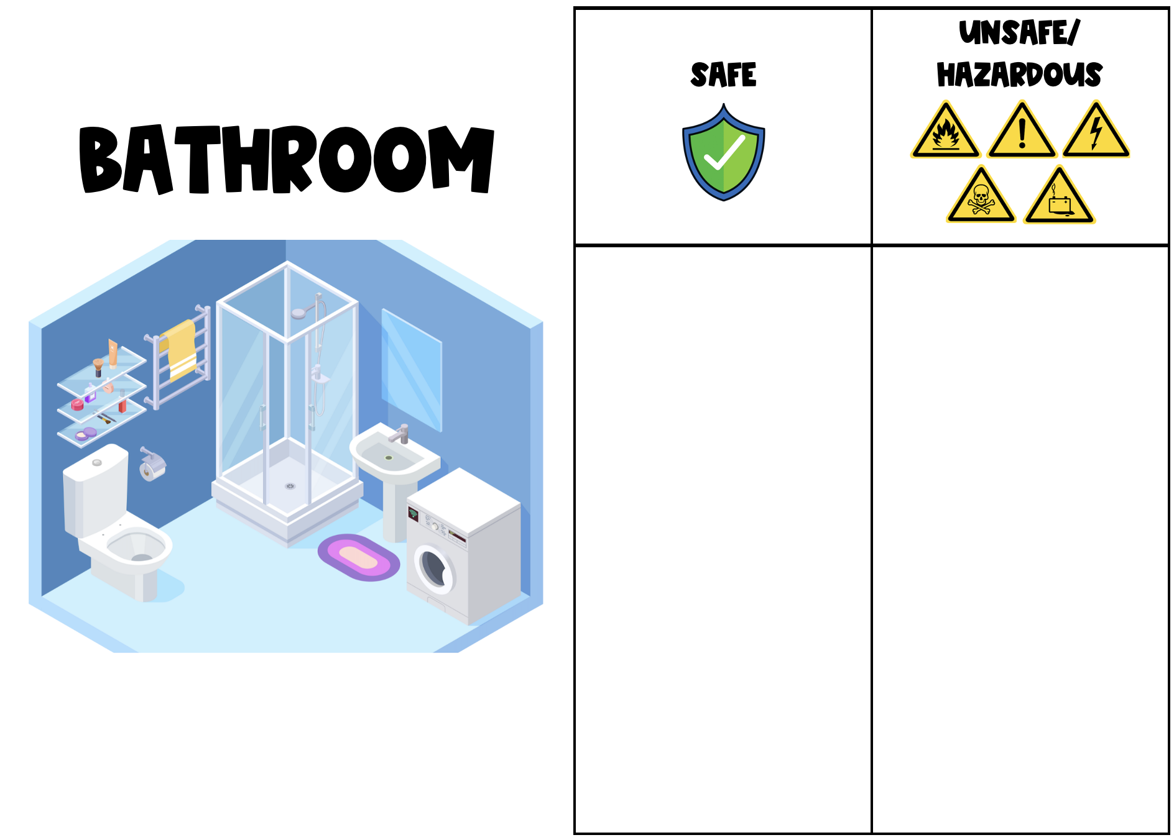
S11e

Slide 16
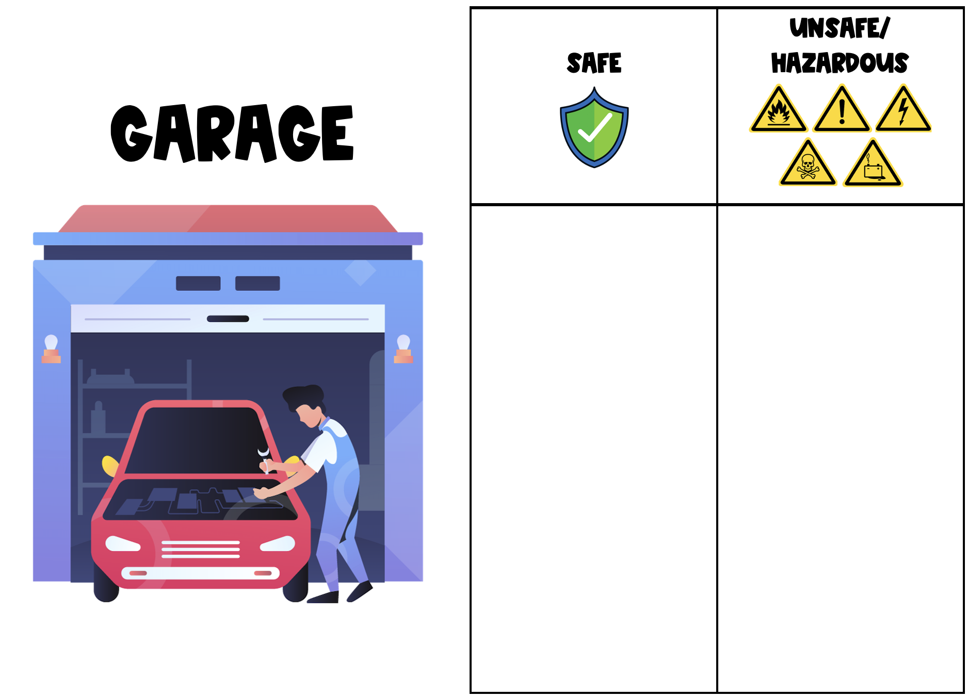
S11f

Slide 17
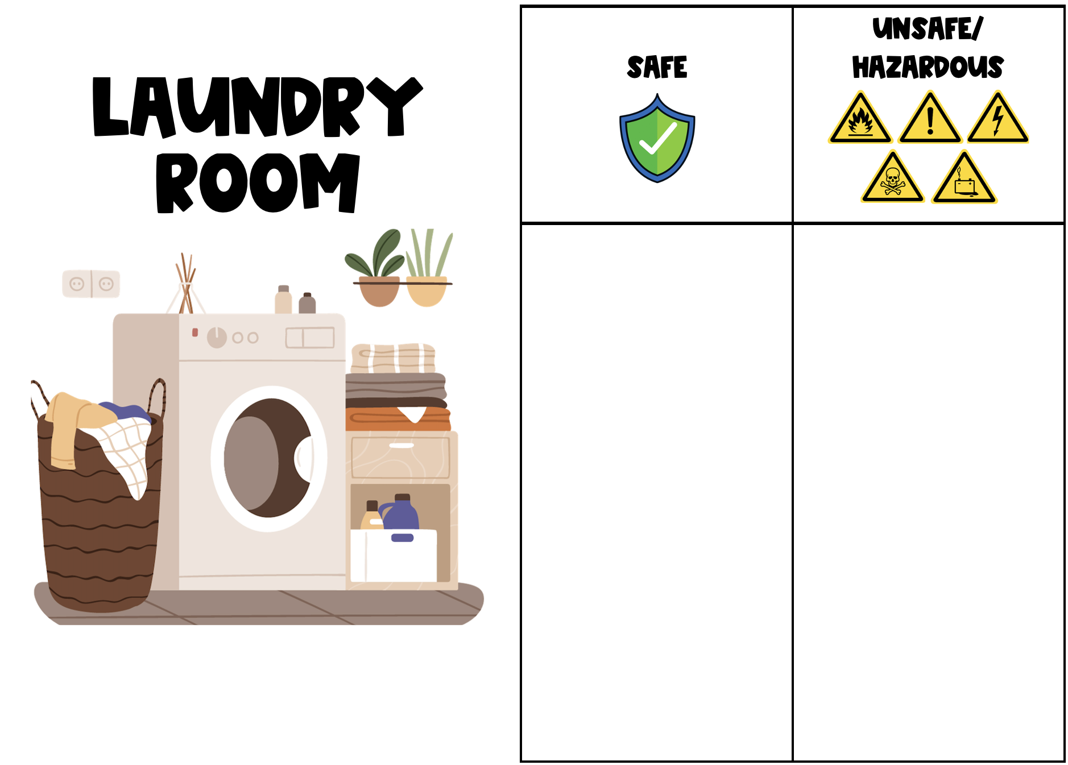
S11g

Slide 18

PROCEDURE - Student Explain
S12
SAFE AND UNSAFE ITEMS - Whole Group Share Out
What is your item?
Where is it located at home?
Is it safe or unsafe/hazardous?

Slide 19
PROCEDURE - Teacher Explain
S13
What is a Household Hazardous Waste (HHW)?

Slide 20

ACADEMIC/SCIENTIFIC VOCABULARY
S14
HOUSEHOLD HAZARDOUS WASTE
(HHW)
A product usually found in places where people dwell labeled toxic, poisonous, combustible, corrosive, irritant, or flammable

Slide 21
PROCEDURE - Teacher Explain
S15
Where in our homes do we find most HHW?

Slide 22
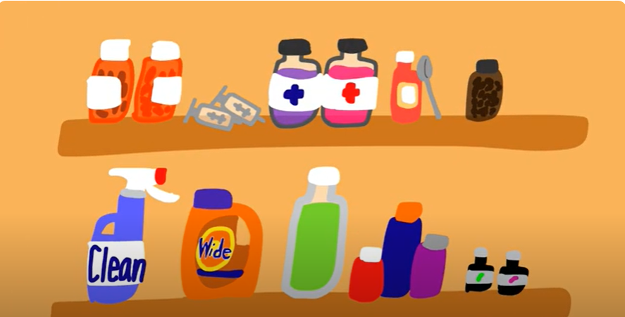
PROCEDURE - Teacher Explain
S16

Slide 23
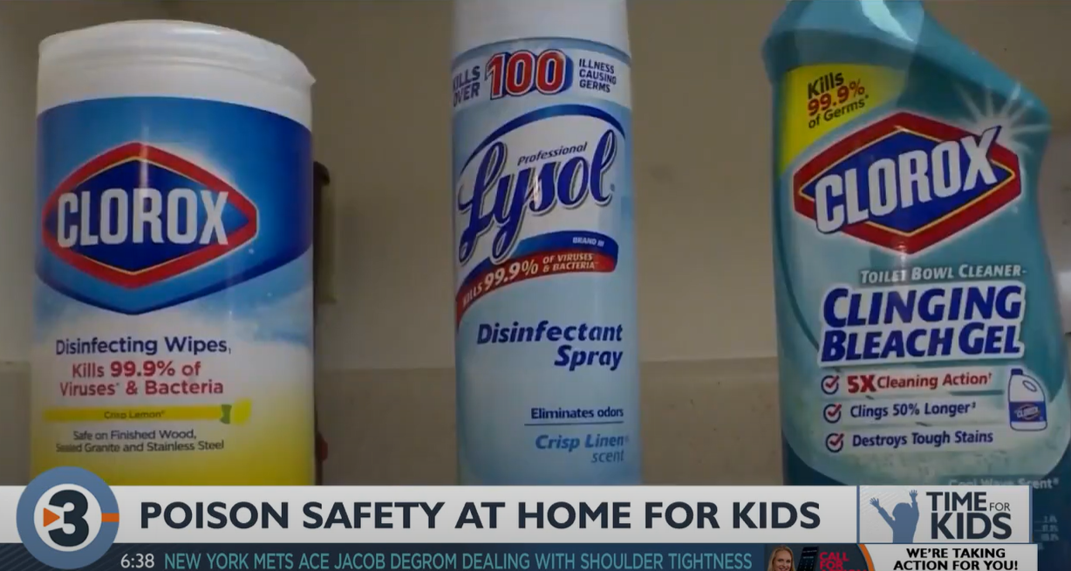
PROCEDURE - Teacher Explain
S17

Slide 24
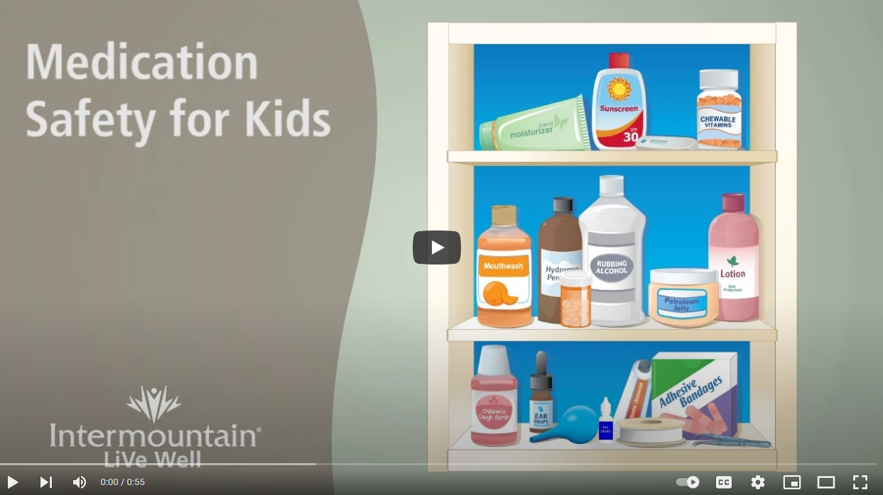
PROCEDURE - Teacher Explain
S18

Slide 25
PROCEDURE - Teacher Explain
S19
What do we do with the unsafe or hazardous items when we don’t use them anymore?

Slide 26
PROCEDURE - Teacher Explain
S20
Do NOT…

Slide 27




PROCEDURE - Teacher Explain
S21

Slide 28
PROCEDURE - Teacher Explain
S22
Do…

Slide 29
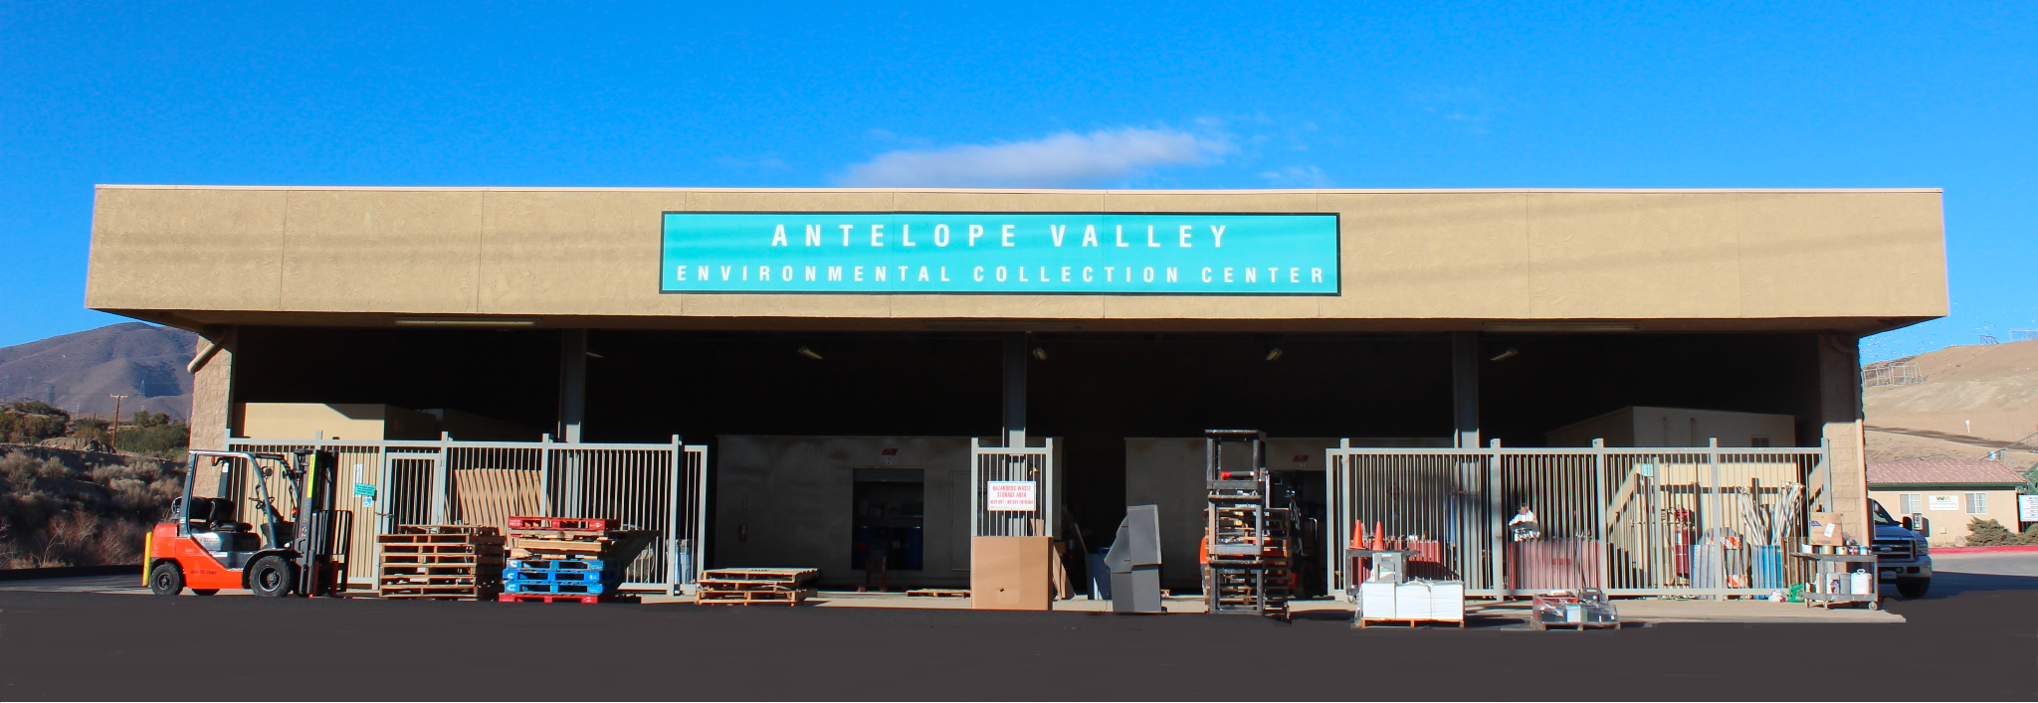
PROCEDURE - Teacher Explain
S23
Take it to a Permanent Collection Center
https://dpw.lacounty.gov/epd/hhw/reuse

Slide 30
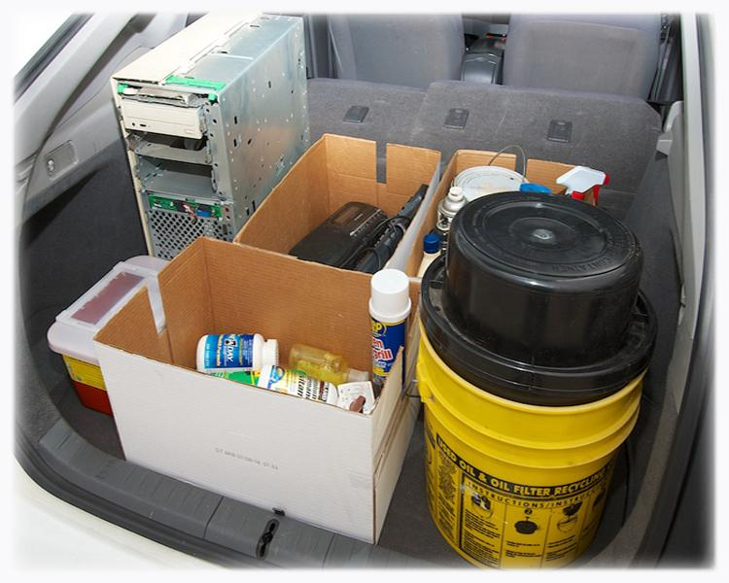
PROCEDURE - Teacher Explain
S24
Other Collection Centers
Permanent Centers
Temporary Events
Household Hazardous Waste (HHW) Disposal
Electronic Waste (E-Waste) Disposal
Household Battery Disposal
Paint Recycling
Pharmaceutical Disposal
Sharps Disposal
Used Motor Oil Collection Centers

Slide 31



ACADEMIC/SCIENTIFIC VOCABULARY
S25a
HOUSEHOLD
People who dwell or live under the same roof or compose a family. A social unit made up of people living together in the same dwelling.

Slide 32



ACADEMIC/SCIENTIFIC VOCABULARY
S25b
HAZARD
A source of danger.
Something that can cause harm or hurt people.

Slide 33




ACADEMIC/SCIENTIFIC VOCABULARY
S25c
WASTE
An unwanted by-product of a manufacturing process, chemical laboratory, or nuclear reactor
Pesticides
Motor Oil
Cleaner

Slide 34
ACADEMIC/SCIENTIFIC VOCABULARY
S25d
HOUSEHOLD HAZARDOUS WASTE
(HHW)
A product usually found in places where people dwell labeled toxic, poisonous, combustible, corrosive, irritant, or flammable

Slide 35
ACADEMIC/SCIENTIFIC VOCABULARY
S25e
SAFETY
The state of being safe, free from risk of injury, danger, or loss. Avoiding or not causing injury, danger, or loss.

Slide 36


ACADEMIC/SCIENTIFIC VOCABULARY
S25f
DISPOSAL
Getting rid of or putting out of the way.

Slide 37

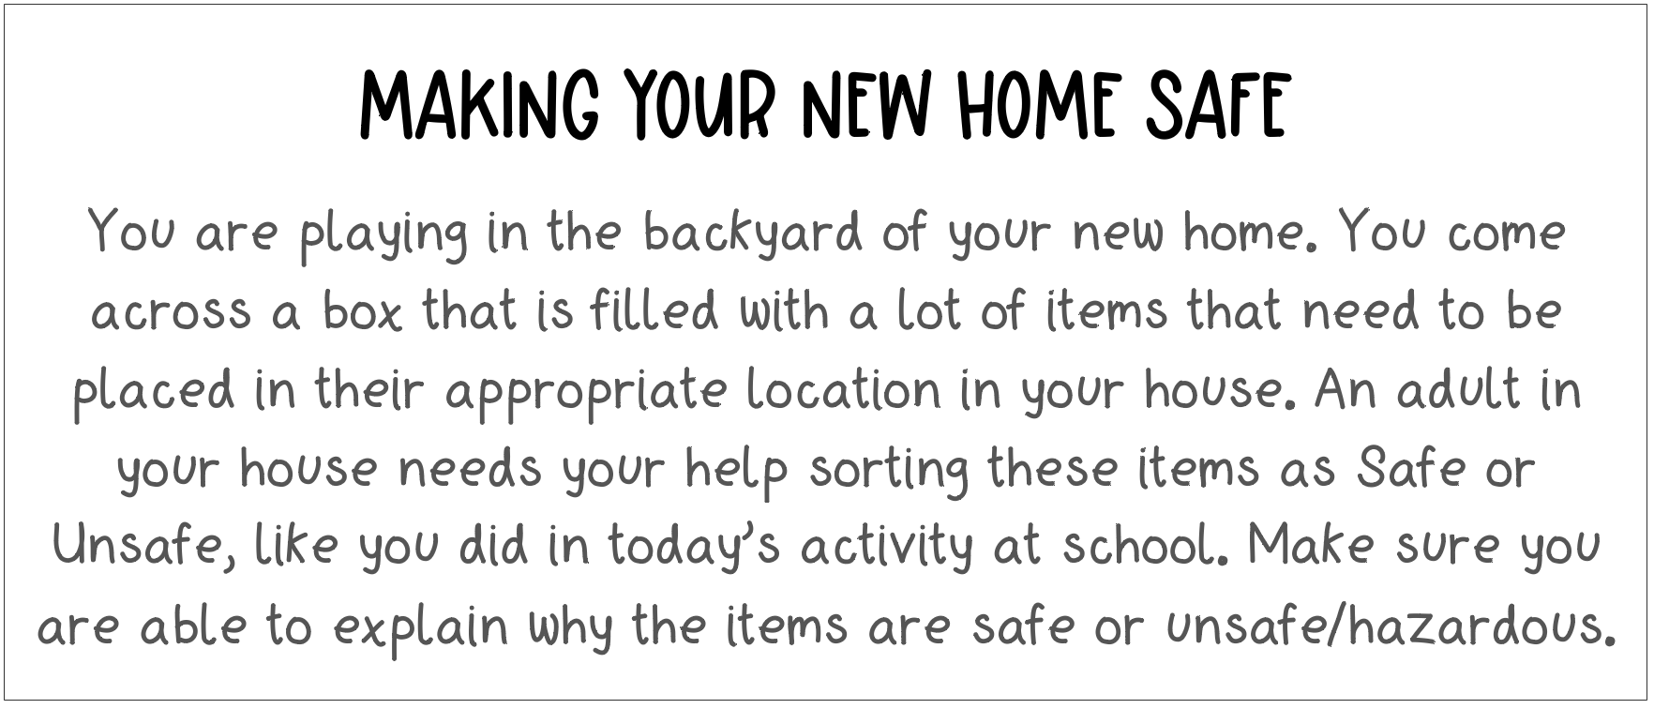
CONCLUSION - Elaborate and Evaluate
S26
Inorganic
Waste

Slide 38
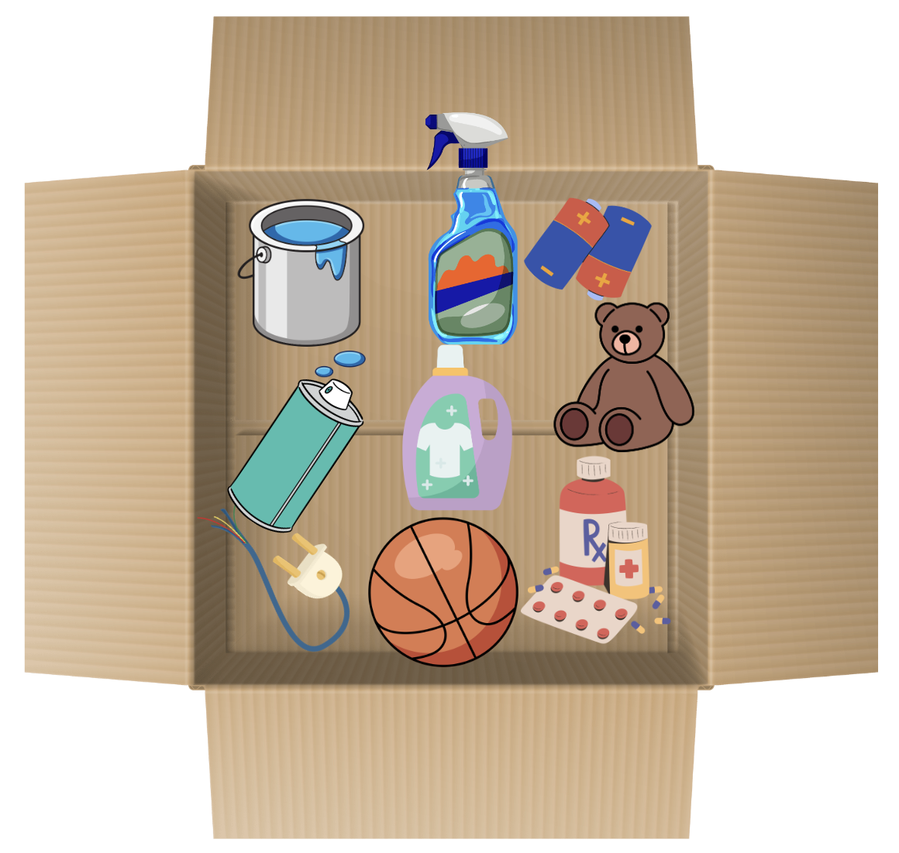
S27
Inorganic
Waste

